Slide 1
STREET LIGHT GENERATION USING PIEZOELECTRIC SENSORS AND WIND TURBINES
Team Member 1 : PRINKAYATTHRA D (221001117)
Team Member 2 : PRATHIBA S (221001114)
Team Member 3 : PRAVEEN KUMAR D I (221001115)
MENTOR : MR. PRAGADEESH
B.Tech – Information Technology – III Year

Slide 2
ABSTRACT
❗ Problem Statement:
In urban environments, street lighting consumes a significant amount of electricity and often relies on non-renewable energy sources. This results in high operational costs, increased carbon emissions, carbon footprints and frequent outages, especially in areas with high traffic density. Conventional infrastructure lacks sustainability, leading to unsafe roads and unreliable illumination.
🎯 User-Centered Need:
There is a need for a self-sustaining, cost-effective, and eco-friendly solution that can reliably power street lighting systems by utilizing untapped renewable energy sources such as mechanical stress from vehicles and wind generated by traffic flow.
INTRODUCTION TO THE PROBLEM
With increasing energy demands and depleting non-renewable resources, there’s an urgent need for sustainable and eco-friendly alternatives
Street lighting, a major part of urban architecture, consumes significant energy- and this project aims to tackle that.
PROJECT OBJECTIVE
To design a hybrid system that generates electricity using:
WIND ENERGY captured through turbine
OUTCOME AND ADVANTAGES
Sustainable power for street lighting
Raises public awareness for renewable energy
PIEZOELECTRIC SENSORS activated by footsteps
Dual source energy generation(footsteps+wind)
Low maintanence and cost - effective
Ideal for high footfall areas like stations, parks, malls
WORKING PRINCIPLE
PIEZOELECTRIC EFFECT: Pressure from footsteps on piezo sensors generates voltage
MONITORING: A Arduino displays voltage data realtime using LCD screen
KEY COMPONENTS
Piezoelectric sensors
LCD Display
KEYPOINT
This project proves that clean energy can be captured from everyday human activity and natural forces. Scalable and impactful, it contributes toward a smarter, greener, and more energy conscious world
WIND ENERGY CONVERSION: A turbine connected to a DC motor produces electricity when wind flows.
ENERGY STORAGE: A capacitor stores the generated power
Turbine + DC Motor
Arduino Uno
Capacitor
Breadboard and connecting wires

Slide 3
EMPATHISE
Category | Details
Who are the users? | 🚐 Daily commuters 🚶 Pedestrians 🧊 Roadside vendors 🏡 Local residents 🏛️ Municipal authorities
What do they need? | ✅ Safe and well-lit roads ✅ Reliable street lighting ✅ Eco-friendly and low-maintenance solutions ✅ Reduced power cuts and outages ✅ Cost-effective infrastructure
What are their pain points? | ⚠️ High energy costs ⚠️ Frequent power outages ⚠️ Overdependence on non-renewable sources ⚠️ Poor visibility in key areas (e.g., speed breakers) ⚠️ Lack of sustainable infrastructure
What are we doing? | 💡 Harnessing vehicle pressure using piezoelectric sensors 🌬️ Capturing wind energy with roadside turbines 🔋 Powering street lights sustainably for safer, greener roads
PROMOTING SUSTAINABLE ENERGY USE
REDUCING URBAN ENERGY COSTS
ENHANCING PUBLIC AWARENESS OF RENEWABLE ENERGY
EMPOWERING URBAN SUSTAINABILITY
TACKLING THE ENERGY ACCESS ISSUE
PROMOTING HEALTH AND SAFETY

Slide 4
EXPLORE
Street lighting systems consume substantial energy, often relying on traditional electricity sources. We aim to explore piezoelectric sensors as a renewable energy solution, converting mechanical energy from traffic or footsteps into electrical power to sustainably power street lights.
TECHNOLOGY USED
Piezoelectric Sensors: These sensors convert mechanical stress into electrical energy.
CHALLENGES AND FEASIBILITY
Low Energy Output: Piezoelectric sensors produce low amounts of electricity, necessitating the use of multiple sensors for adequate power.
PROBLEM STATEMENT
System Integration: Combining sensors, energy storage, and control systems requires careful integration to ensure smooth operation and reliable energy generation.
Efficient Storage and Use: Storing and managing energy efficiently to ensure consistent power supply for street lights remains a significant challenge.
Wind Turbine + DC Motor: A wind turbine connected to a DC motor will generate additional electrical energy from wind, complementing the piezoelectric energy harvest.
Arduino Controller: Manages the energy flow from both sensors and turbine, storing it in a capacitor for use in street lighting.
Energy Storage (Capacitor): Stores generated energy to power street lights, ensuring continuous operation even during low mechanical activity.

Slide 5
DEFINE
1. Dual-Source Power
👣 Footstep Energy + Wind Energy = 24/7 Renewable Lighting
2. Human-Driven Innovation
⚡Harvests energy from everyday footsteps in crowded spaces
3. Best Design
🏙️Fits anywhere – from parks to city walkways. Modular & adaptable!
4. Budget-Friendly Brilliance
💸Low-cost components, high-impact output = Sustainable for cities!
5. Live Energy Feedback
📊Real-time power tracking via Arduino + LCD = Smart monitoring made simple!
6. Eco-Friendly
🌱Seamlessly blends with urban life, minimal disruption, maximum awareness!
✨💚 Lighting up cities — one step and one breeze at a time! 💚✨

Slide 6
IDEATE
In this phase, we aimed to develop an innovative solution to address the growing energy demands of urban environments while promoting sustainability.
Problem Statement:
Traditional street lights consume significant electricity.
Kinetic energy from footsteps and vehicles goes unused.
Urban areas need greener, cost-effective alternatives.
Idea Development:
Capture kinetic energy using piezoelectric sensors placed under pavements or roads.
Convert this energy into electrical power using a rectifier and storage unit.
Proposed Solution:
Utilize the generated energy to power LED street lights in high-traffic areas.
Illuminate walkways, parks, and footbridges without depending on traditional power grids.
Outcome:
A smart, green, and scalable idea that turns everyday movement into useful energy—reducing electricity bills and supporting urban sustainability goals.

Slide 7
PROTOTYPE
Our prototype is a working model that demonstrates how mechanical pressure from footsteps or moving vehicles can be converted into usable electrical energy using piezoelectric sensors. This energy is then stored and used to power a streetlight system, along with other small-scale urban utilities.
Key Components:
Piezoelectric Sensors – Convert mechanical stress into electrical voltage.
Bridge Rectifier & Capacitor – Rectify and store the generated AC voltage.
Rechargeable Battery – Stores energy for consistent power supply.
LED Street Light – Low-power lighting solution powered by stored energy.
Arduino Microcontroller – Monitors voltage and controls output display.
LCD Display – Shows real-time voltage generated.
DC Motor + Mini Turbine – Demonstrates hybrid energy collection (optional wind input).
Prototype Highlights:
Lights turn on when energy is generated through foot pressure.
Voltage readings displayed live on the LCD.
Demonstrates both clean energy generation and practical usage in real time.
Compact setup designed for urban sidewalks, parks, and public areas.

Slide 8
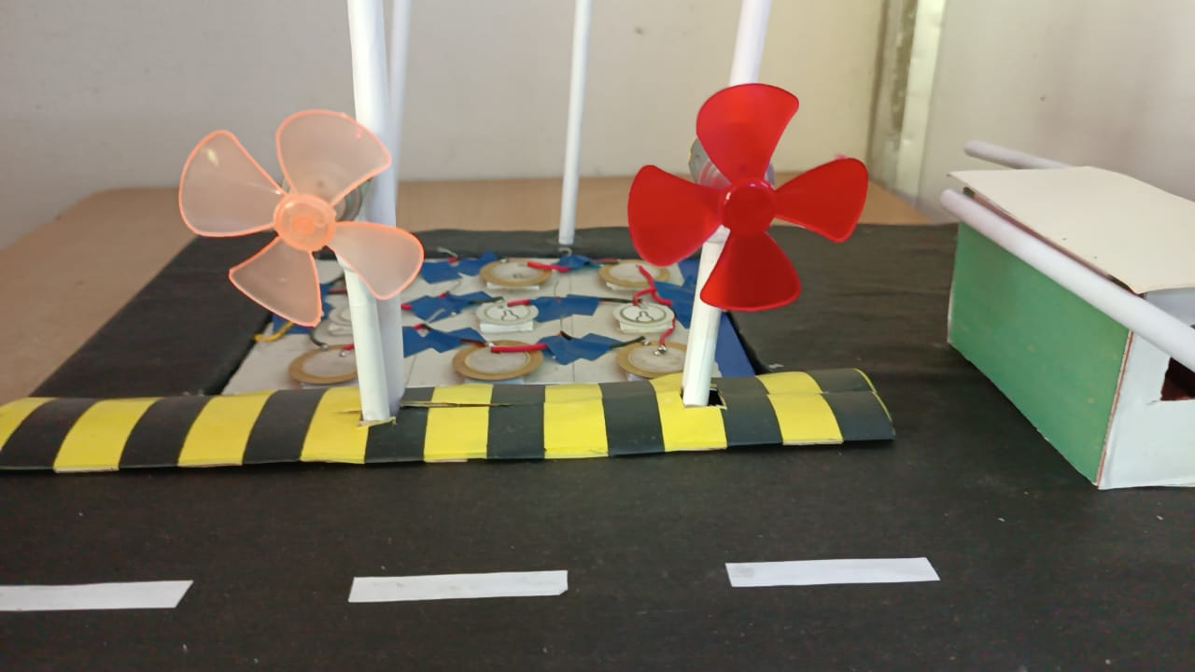
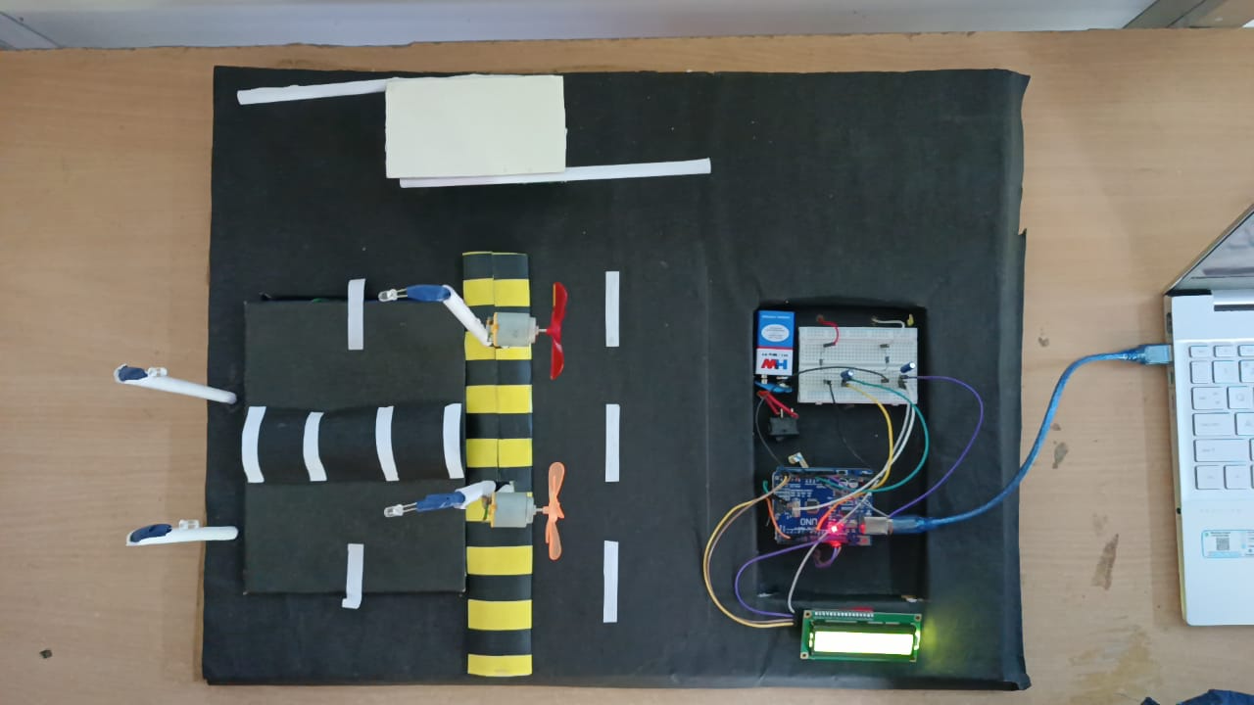
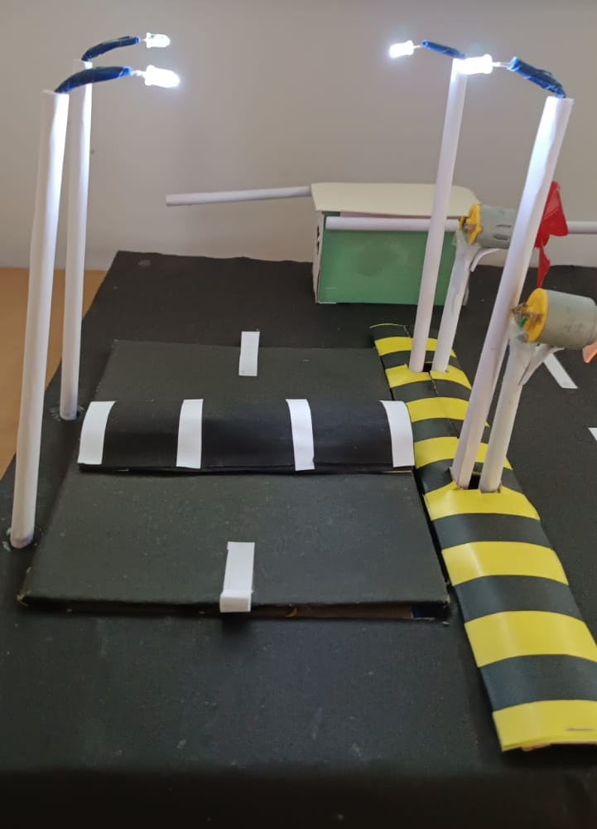
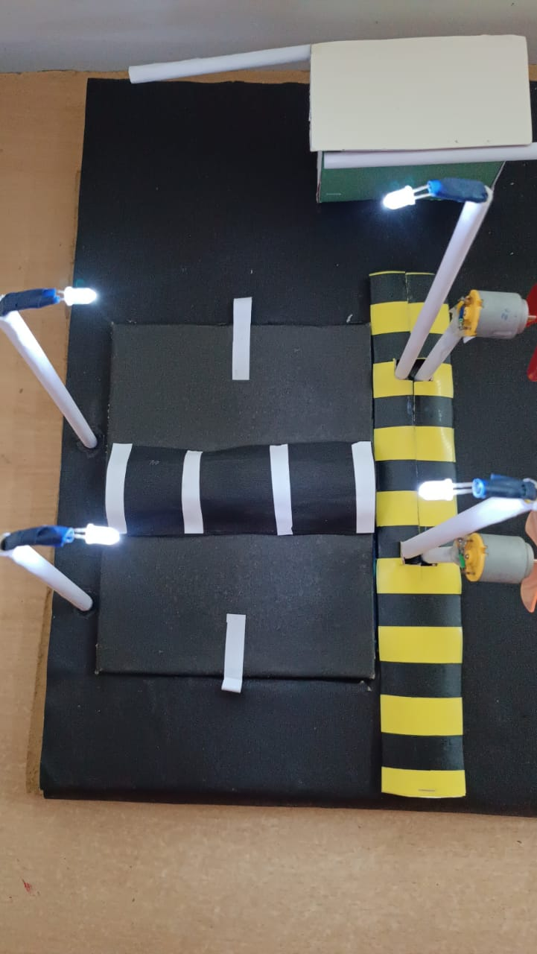
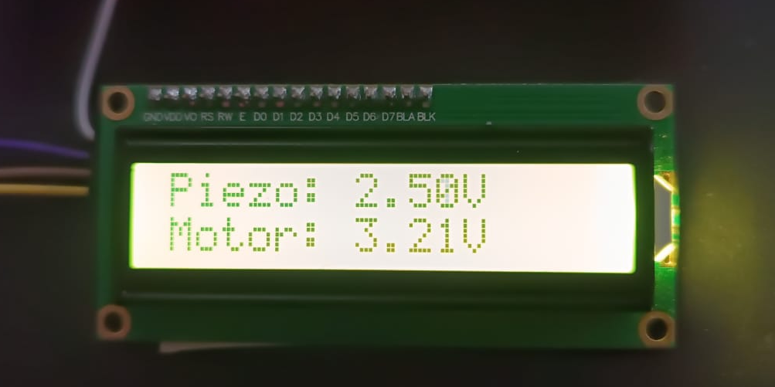
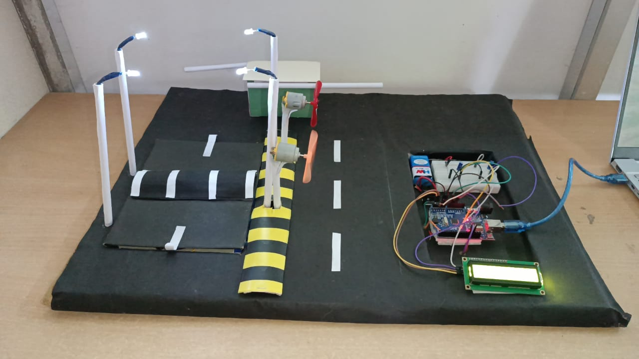
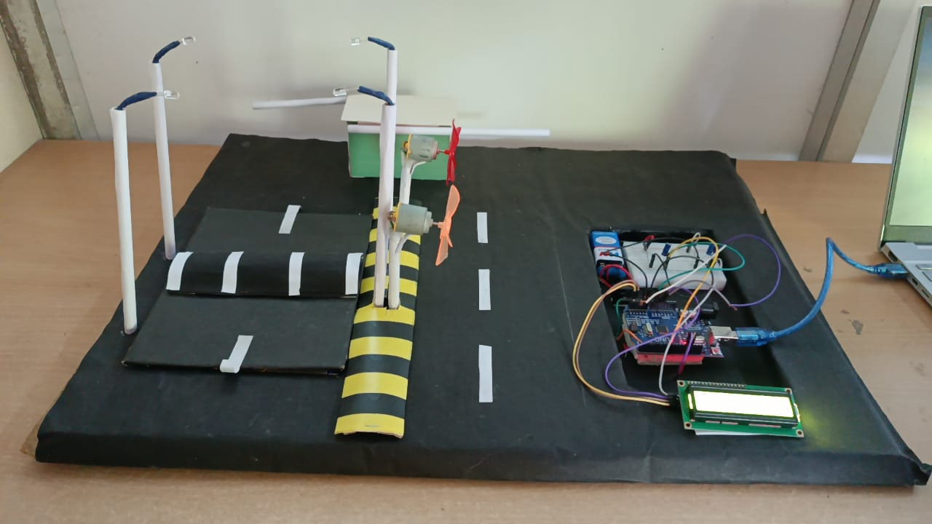
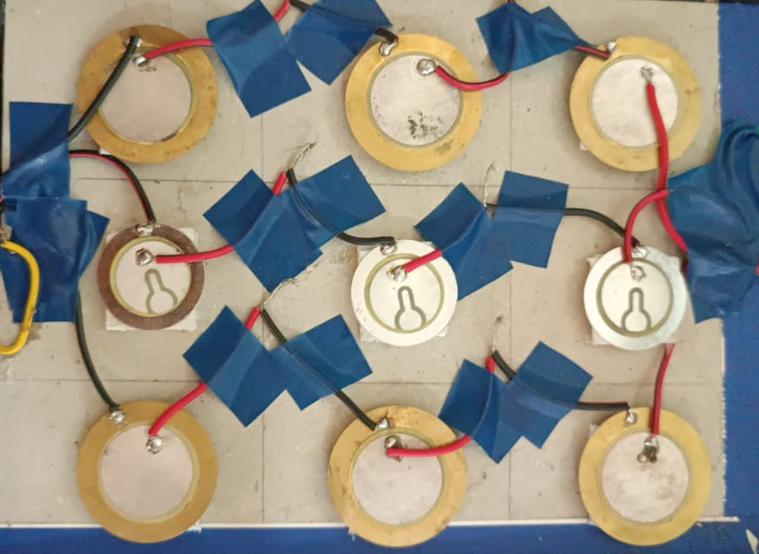


Slide 9
TESTING
PIEZOELECTRIC SENSORS
LCD DISPLAY
WIND ENERGY TURBINE AND DC MOTOR
CAPACITORS FOR ENERGY STORAGE
ARDUINO MICROCONTROLLER
BREADBOARD AND WIRES
LED STREET LIGHTS
🔩 Component | ⚙️ Specification | 🧪 Test Method | ⚡ Energy Output
Piezoelectric Sensor | Size: 35 mm diameter Thickness: 0.4–0.6 mm Weight Capacity: 500–1000 N (approx. 50–100 kg) | Applied hand pressure and weighted load on sensor placed under mock speed breaker | 1–3 V per sensor (under ~70–90 kg pressure)
Wind Turbine DC Motor | Turbine Diameter: 15–20 cm Blade Length: 7–10 cm Fan Wind Speed: 5–12 m/s | Directed wind using table fan simulating traffic wind | 5–12 V DC generated (depending on wind speed and blade RPM)
Capacitor | 1000 µF – 4700 µF Voltage Rating: 25V | Connected to piezo & motor output | Stored bursts of energy; discharged smoothly to light LED
Arduino + LCD | Arduino UNO R3 16x2 LCD | Measured voltage and displayed it on LCD in real-time | LCD output matched multimeter readings
LED Output | 5V white LED lights | Connected via stored charge in capacitor and battery | Turned on when voltage threshold reached (~3V+)

Slide 10
CONCLUSION
The Piezoelectric Street Light System demonstrates an innovative and sustainable solution to meet urban energy needs by harnessing mechanical energy from foot traffic and vehicles. By converting everyday movements into electrical energy, this project not only supports energy-efficient lighting, but also paves the way for smart city applications.
Our prototype showcases how clean energy can be harvested from human activity, and with further development, it has the potential to power eco-friendly systems like misting units, park irrigation, and green urban infrastructure. This project reflects the future of renewable energy, smart design, and environmental responsibility, making cities greener and more self-sufficient.
Additionally:
It promotes public awareness about renewable energy through real-time demonstrations in public spaces.
The system can reduce dependency on conventional power grids, making urban areas more resilient during power outages.
This project reflects the future of renewable energy, smart design, and environmental responsibility, making cities greener and more self-sufficient.

Slide 11
FUTURE WORK
MISTING SYSTEM INTEGRATION: Use the harvested energy to power misting systems in parks and urban hotspots for temperature control and enhanced public comfort.
AUTOMATED PARK IRRIGATION: Channel stored energy for drip or sprinkler irrigation systems, promoting water-efficient green spaces.
V-CANOPY PLANT SUPPORT: Power small lighting and irrigation units for vertical canopy plant structures, enhancing urban biodiversity and aesthetics.
TUDD (TREE-BASED URBAN DRAINAGE DESIGN) SYNERGY: Combine piezo energy with tree-based water management systems to support sustainable drainage and smart landscaping.
GREEN URBAN INFRASTRUCTURE: Utilize the setup to support low-power garden lighting, sensor-based soil monitoring, and environmental data collection.
SMART ECO-BENCHES: Implement benches with USB charging ports, misting fans, and lighting—all powered by piezoelectric energy.
ECO-FRIENDLY URBAN FURNITURE: Develop low-power installations like information boards, illuminated walkways, and art displays using harvested energy.

Slide 12
REFERENCES
R E F E R E N C E S
* SUSTAINABLE URBAN LIGHTING SOLUTIONS:
Chien, S., & Yu, C. (2019). "Sustainable Urban Lighting: The Role of Renewable Energy."Energy Reports, 5, 123-129. https://doi.org/10.1016/j.egyr.2019.03.003
* ARDUINO FOR ENERGY MANAGEMENT SYSTEMS:
Mohammad, M., & Rahman, R. (2018). "Arduino-Based Energy Management System for Smart Cities." International Journal of Electrical and Computer Engineering, 12(2), 231-237. [Link: https://doi.org/10.11591/ijece.v12i2.7740]
* WIND ENERGY CONVERSION:
Liu, L., & Zhang, Y. (2017). "Wind Energy Generation and Utilization: An Overview."Renewable Energy, 101, 123-134. https://doi.org/10.1016/j.renene.2016.09.049
* PIEZOELECTRIC ENERGY HARVESTING:
Sharma, M., & Gupta, R. (2016). "Piezoelectric Energy Harvesting Systems: A Review."Journal of Renewable and Sustainable Energy, 8(4), 035801.
Piezoelectric Energy Harvesting Systems: A Review — Sharma, M., & Gupta, R. (2016)
* PIEZOELECTRICITY AND FOOTSTEP POWER: Tian, X., & Liu, J. (2015). "Energy Harvesting Using Piezoelectric Materials from Footsteps."Applied Physics Letters, 107(5), 053902. https://doi.org/10.1063/1.4928111

